Slide 1

Chapter 1
National Income
BVRIT Hyderabad College of Engineering for Women

Slide 2


National Income - Concepts
BVRIT Hyderabad College of Engineering for Women

Slide 3

BVRIT Hyderabad College of Engineering for Women

Slide 4
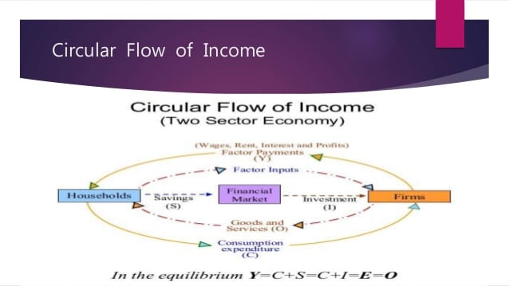
BVRIT Hyderabad College of Engineering for Women

Slide 5

BVRIT Hyderabad College of Engineering for Women

Slide 6

BVRIT Hyderabad College of Engineering for Women

Slide 7

BVRIT Hyderabad College of Engineering for Women

Slide 8

BVRIT Hyderabad College of Engineering for Women

Slide 9

BVRIT Hyderabad College of Engineering for Women

Slide 10
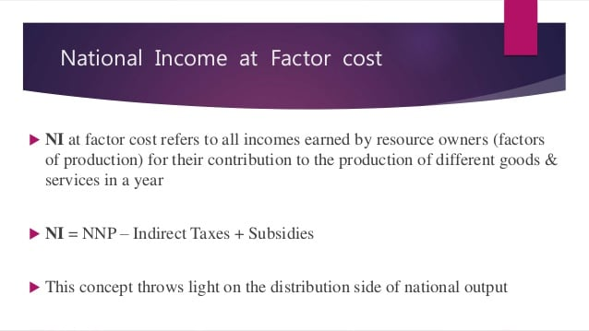
BVRIT Hyderabad College of Engineering for Women

Slide 11

BVRIT Hyderabad College of Engineering for Women

Slide 12

BVRIT Hyderabad College of Engineering for Women

Slide 13

BVRIT Hyderabad College of Engineering for Women

Slide 14

BVRIT Hyderabad College of Engineering for Women

Slide 15
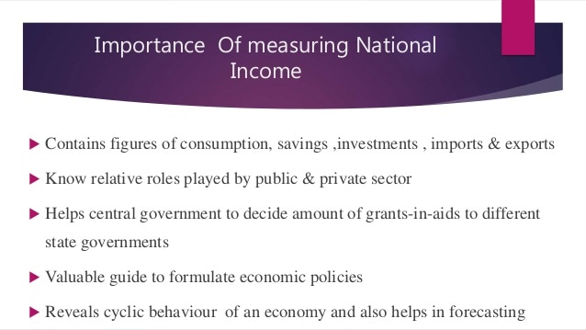
BVRIT Hyderabad College of Engineering for Women

Slide 16
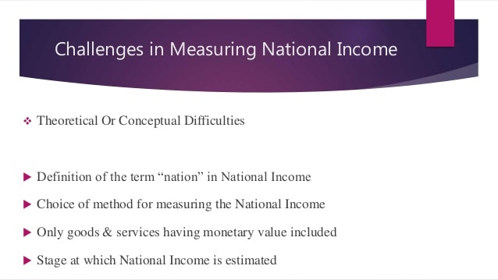
BVRIT Hyderabad College of Engineering for Women

Slide 17

BVRIT Hyderabad College of Engineering for Women

